Slide 1
MassMutual DSDP 2017: Introduction to Data Visualization
June 8, 2017
R. Jordan Crouser & Amelia McNamara
Statistical & Data Sciences
Smith College

Slide 2


People
Jordan
(computer scientist)
Amelia
(statistician)

Slide 3
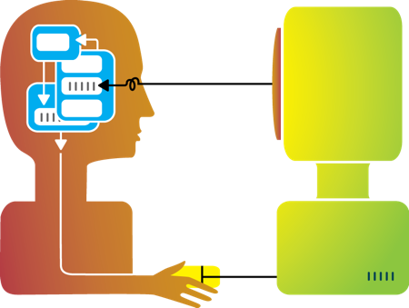
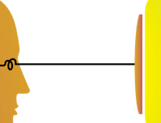
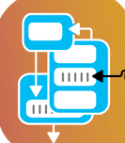


Our research (broadly)
Visualization
Cognitive
Science
Interaction
Design
Computational
Modeling

Slide 4
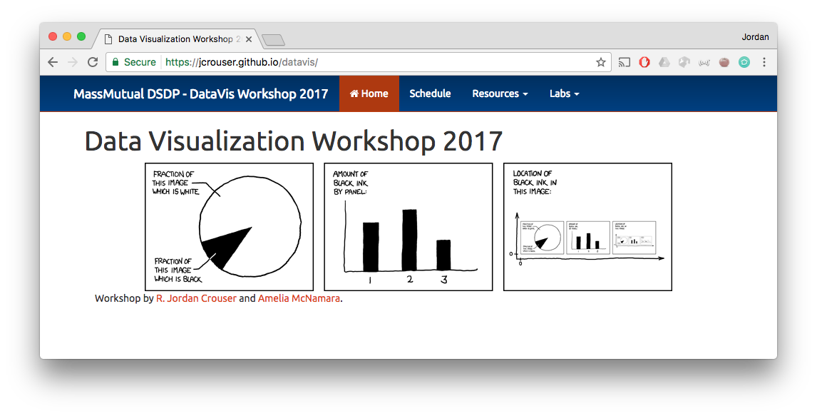
Housekeeping
jcrouser.github.io/datavis

Slide 5
About this course
Visualization

Slide 6
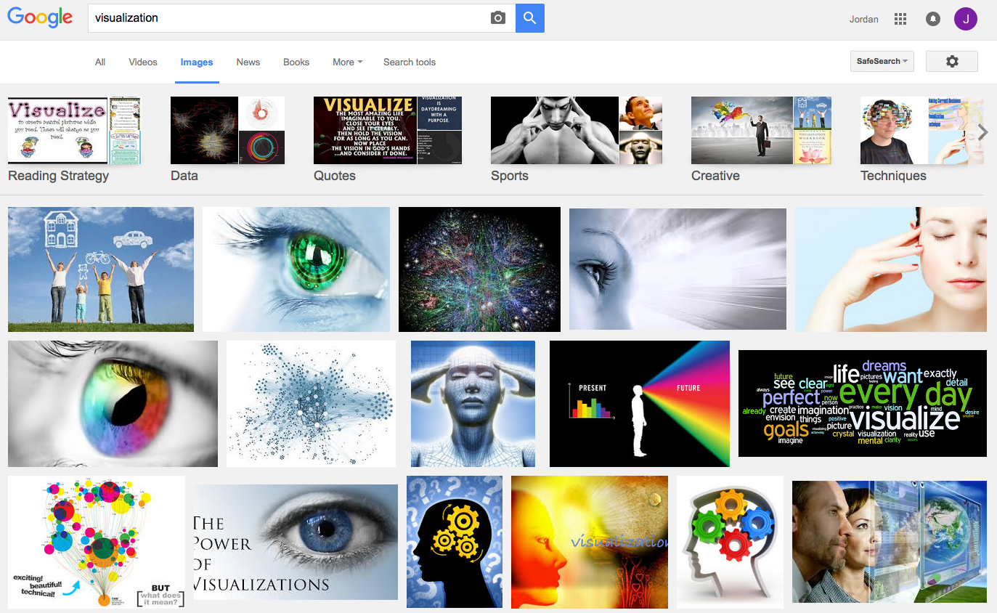
What is visualization?

Slide 7
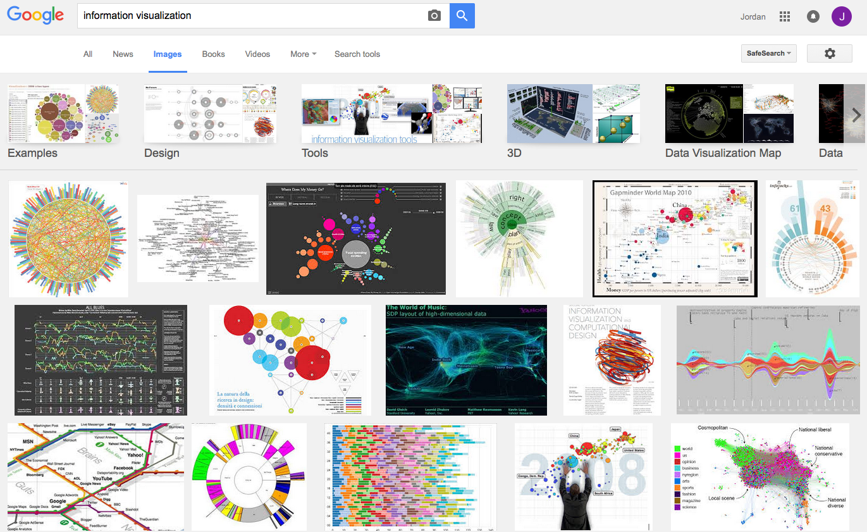
What is visualization?

Slide 8
Perhaps a more helpful question:
What are some ways
a “visualization” can be useful?

Slide 9
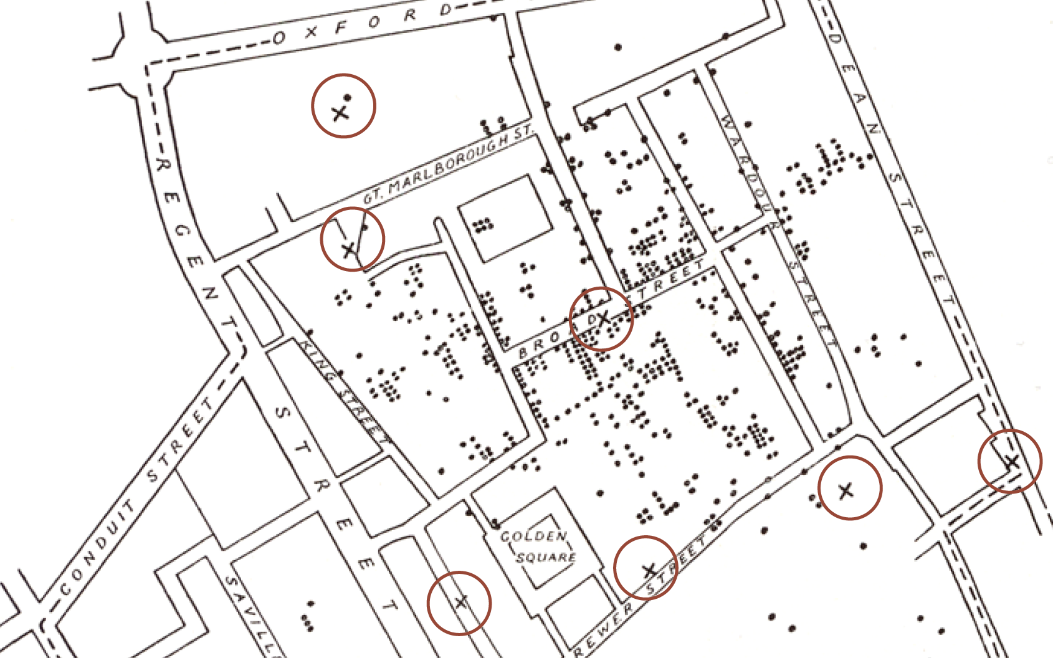
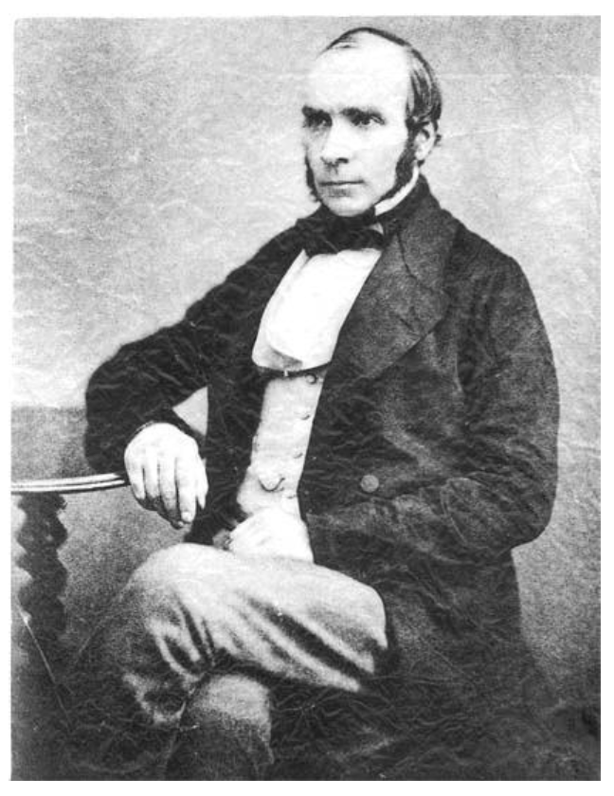
Does it help you spot trends?
In 1854, cholera broke out in London
127 people near Broad St. died within 3 days
616 people died within 30 days
Initial explanation:
“Miasma in the atmosphere”
Dr. John Snow was the first to link the outbreak to contaminated water
How did he do it?
Talked to local residents
Identified a water pump as a likely source
Used maps to illustrate his theory
Convinced authorities to disable the pump
More info here: http://en.wikipedia.org/wiki/1854_Broad_Street_cholera_outbreak

Slide 10
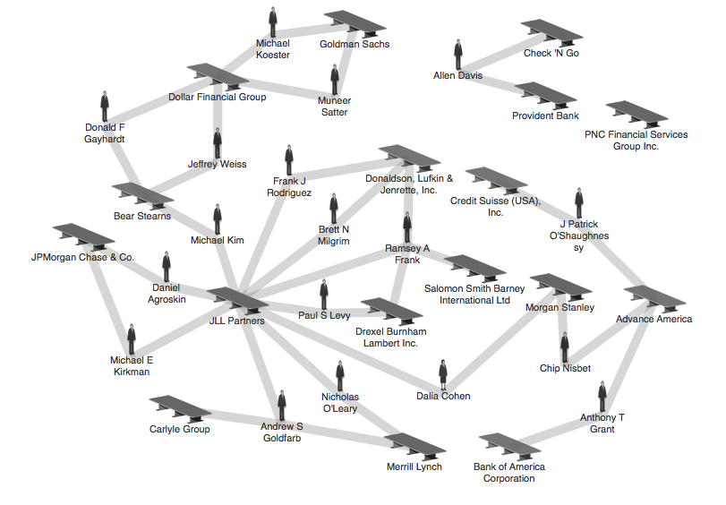
Does it help you explore?
Credit: theyrule.net

Slide 11

Does it tell a story?
Hans Rosling’s 200 Countries, 200 Years, 4 Minutes – The Joy of Stats – BBC Four
https://www.youtube.com/watch?v=jbkSRLYSojo

Slide 12
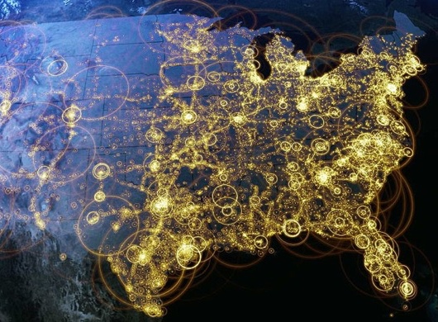
Visualization (def.)
Visual representations of data that reinforce human cognition
Notes:
Image from StackOverflow: http://i.stack.imgur.com/hbO8v.jpg

Slide 13
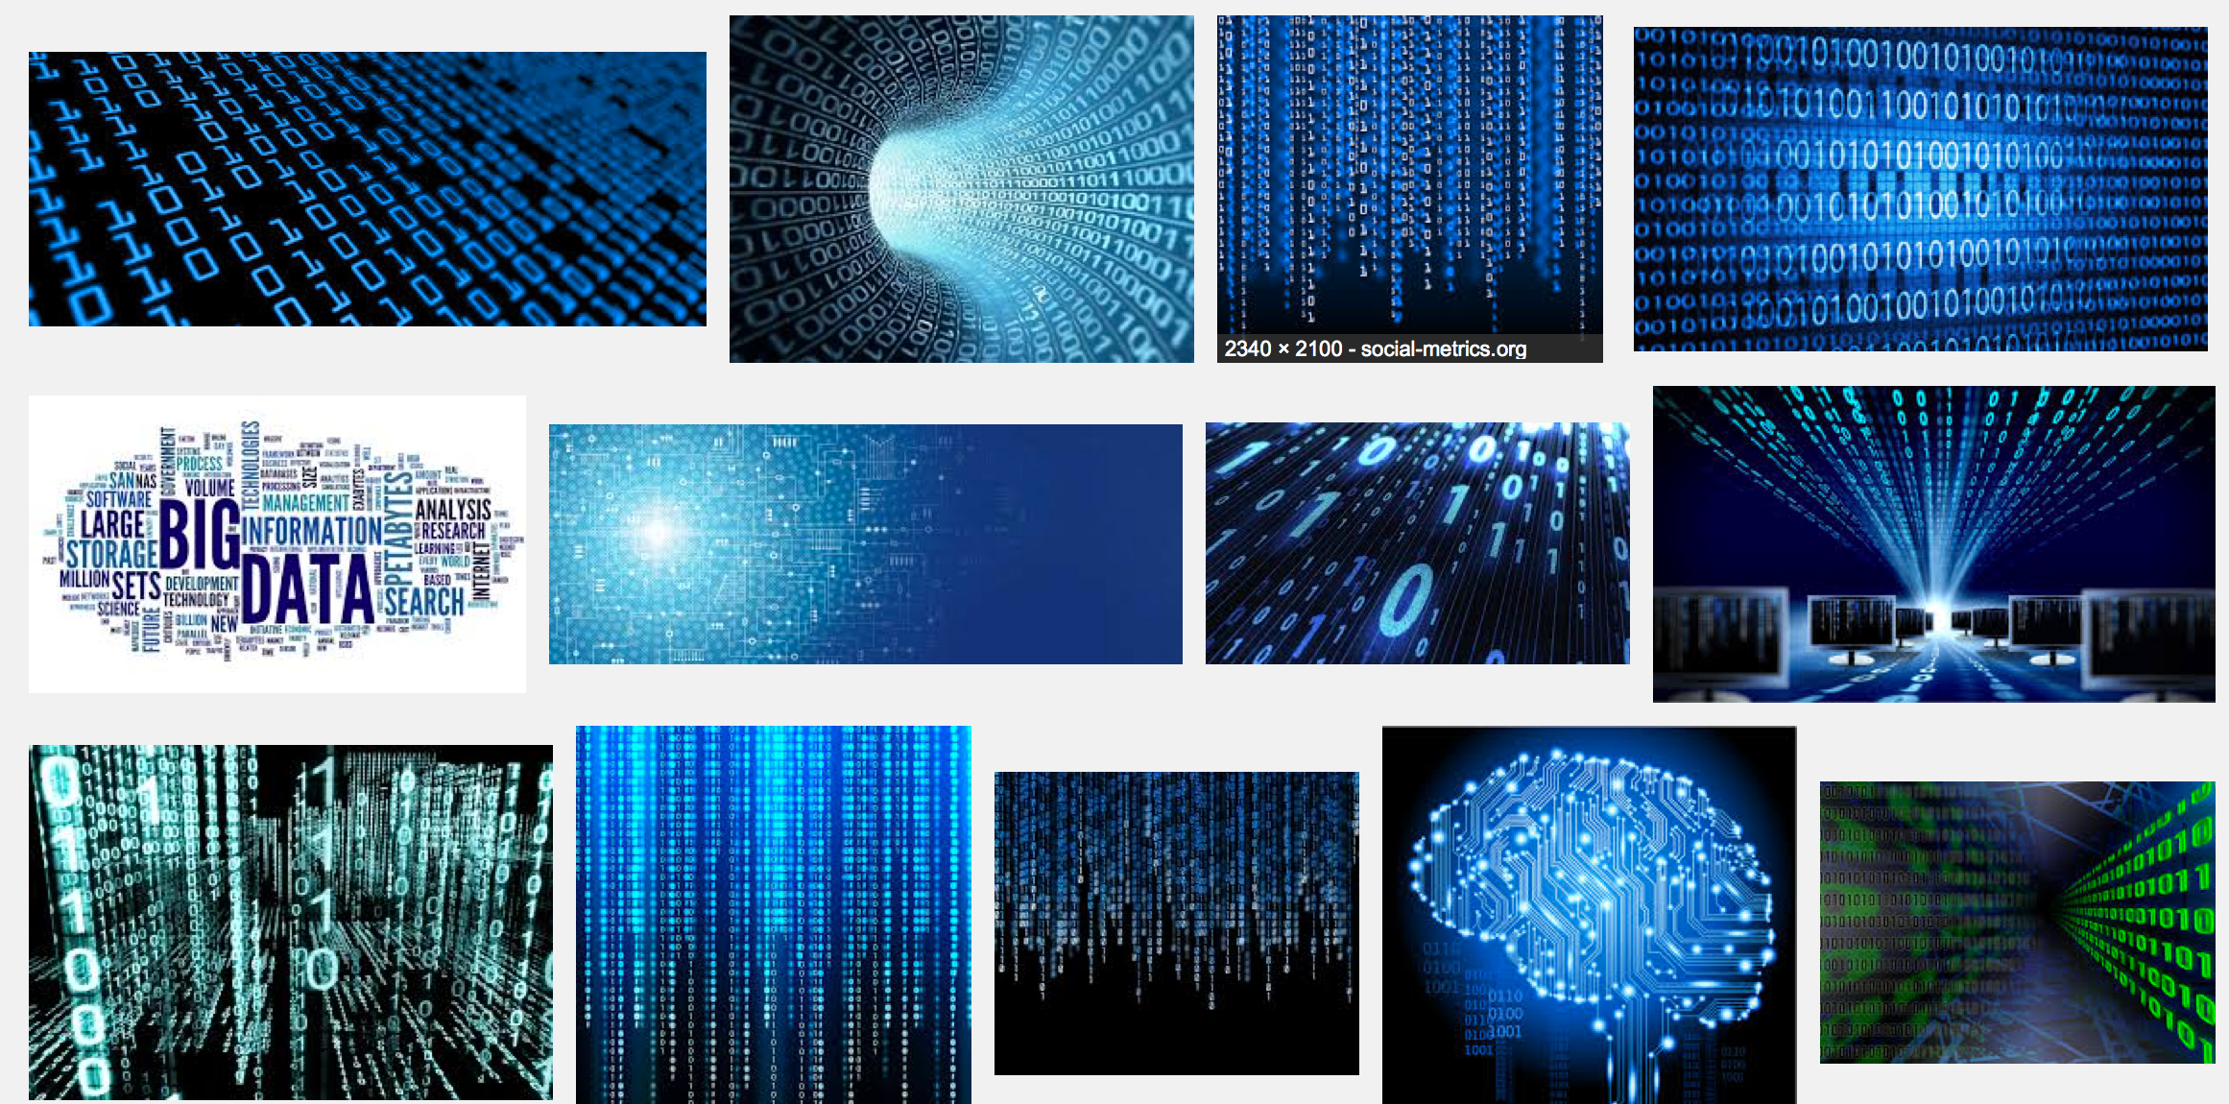
Wait… what is “data”?

Slide 14

Data: a definition
Data is a set of variables that capture various aspects of the world:
Tuition rates,
enrollment numbers,
public vs. private, etc.

Slide 15

Data: a definition
A dataset also contains a set of observations (also called records) over these variables. For example:
tuition = $46,288,
enrollment = 2,563,
private, etc.

Slide 16
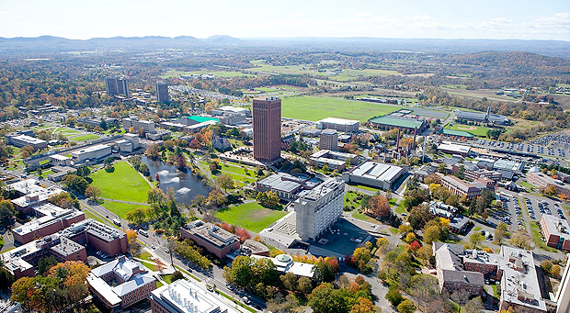

Data: a definition
A dataset also contains a set of observations (also called records) over these variables. For example:
tuition = $16,115,
enrollment = 28,635,
public, etc.

Slide 17
One way to think about this:
VARIABLES
 | Tuition | Enrollment | Public vs. Private | …
Smith College | $46,288 | 2,563 | private
UMass Amherst | $16,115 | 28,635 | public
Hampshire College | $48,065 | 1,400 | private
Mount Holyoke College | $43,886 | 2,189 | private
Amherst College | $50,562 | 1,792 | private
⋮
OBSERVATIONS

Slide 18
Another way to think about this
class school_obs:
def __init__(tuition, enrollment,
pub_or_priv):
self.tuition = tuition
self.enrollment = enrollment
self.pub_or_priv = pub_or_priv
smith = school_obs(46288, 2563, “private”)
umass = school_obs(16115, 28635, “public”)
VARIABLES
OBSERVATIONS

Slide 19
Why is this important?
Data have dimensions
Visualizations have dimensions, too
To build visualizations, we need to map data dimensions to visual dimensions

Slide 20
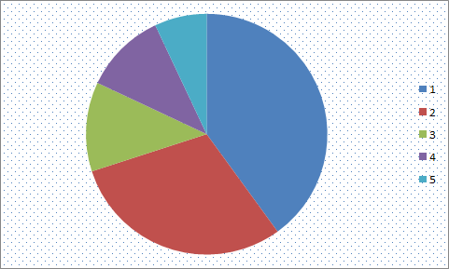
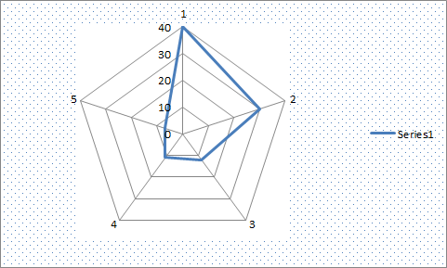
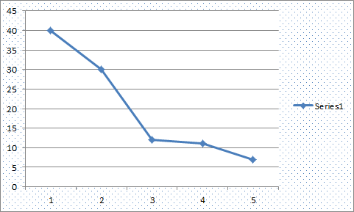
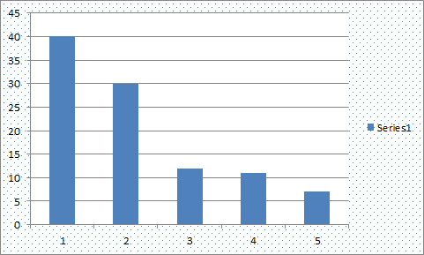
Key question for this course
Which data dimension should be mapped
to which visual dimension?

Slide 21
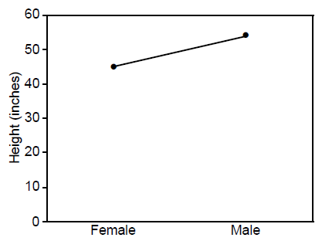
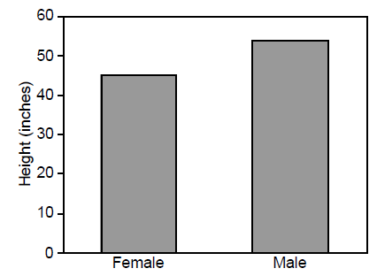
Answer: it depends
Average Height for Youth Sports Participants
Crew Basketball
Crew Basketball

Slide 22

A quick history lesson…

Slide 23
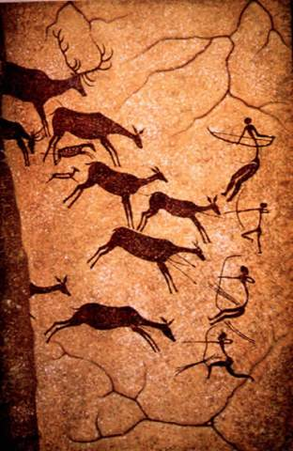
(Incomplete) History of Visualization: 15,000BC
15,000 BC. Laxcaux, France

Slide 24
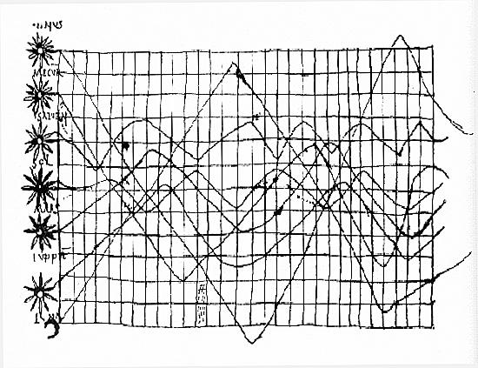
(Incomplete) History of Visualization: 900s
“De cursu per zodiacum”, illustrator unknown
Notes:
Oldest known attempt to show changing values graphically
Inclinations of the planetary orbits over time
An handwritten appendix in the back of a copy of Macrobius' Commentary on Cicero's Somnium Scipionis sitting in a library in Munich.

Slide 25
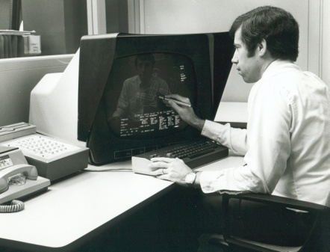
(Incomplete) History of Visualization: 1970s
CAD/CAM, building cars, planes, chips
Starting to think about: 3D, animation, edu, medicine

Slide 26
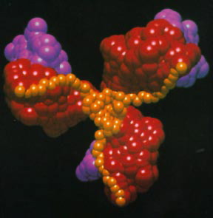
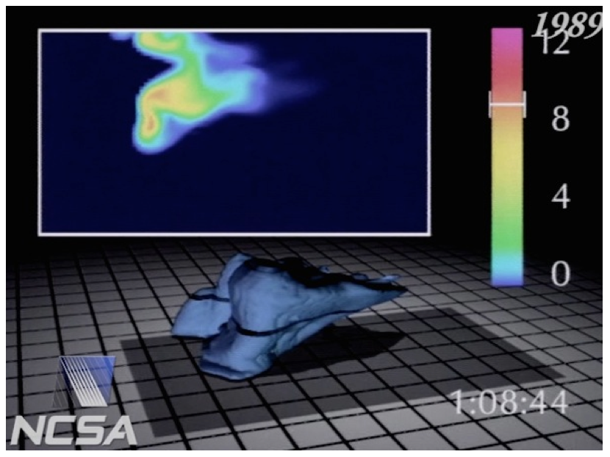
(Incomplete) History of Visualization: 1980s
Scientific visualization, physical phenomena
Starting to think about: photorealism, entertainment

Slide 27
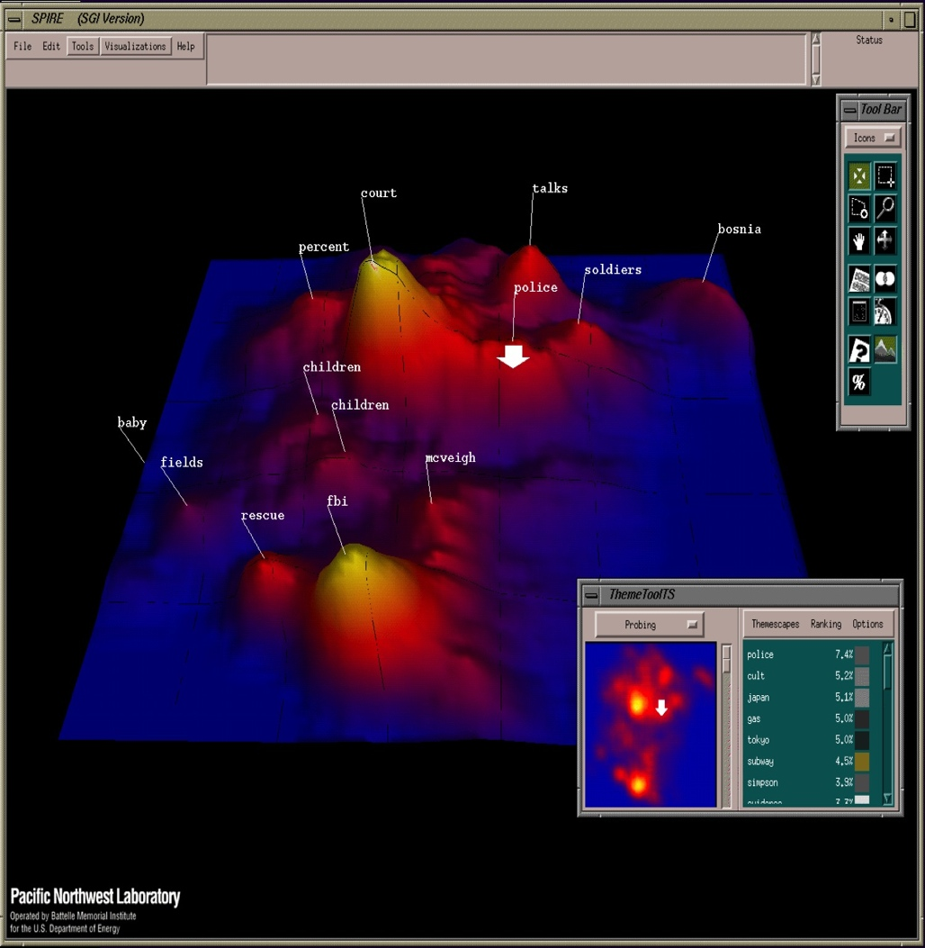
(Incomplete) History of Visualization: 1990s
Information visualization, storytelling
Starting to think about: online spaces, interaction

Slide 28
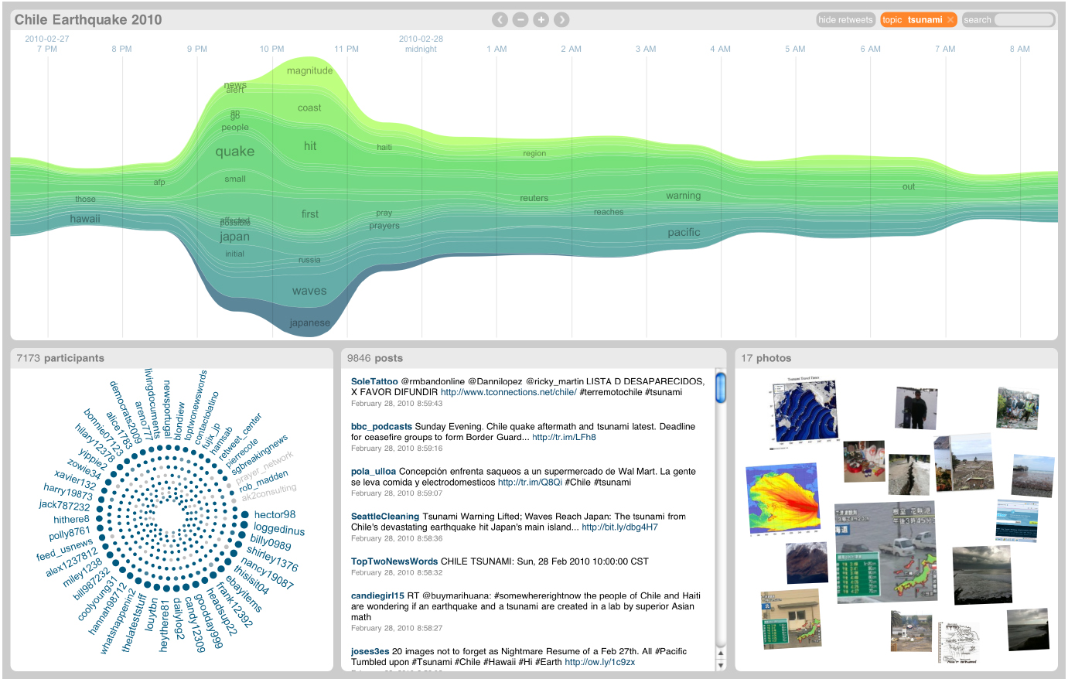
(Incomplete) History of Visualization: 2000s
Coordination across multiple views, interaction
Starting to think about: sensemaking, provenance

Slide 29
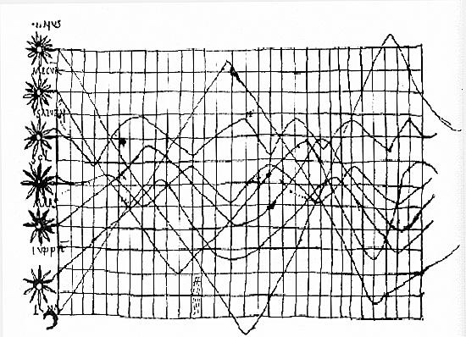
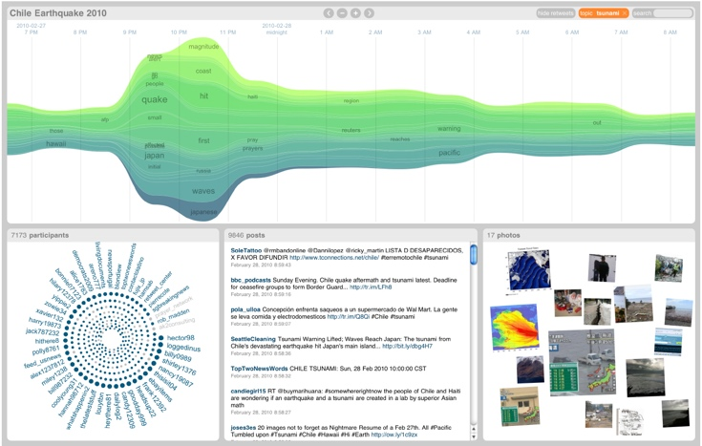
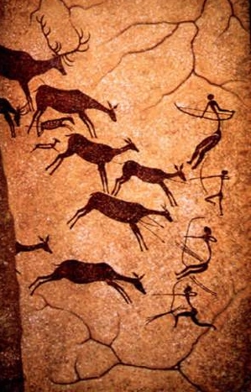
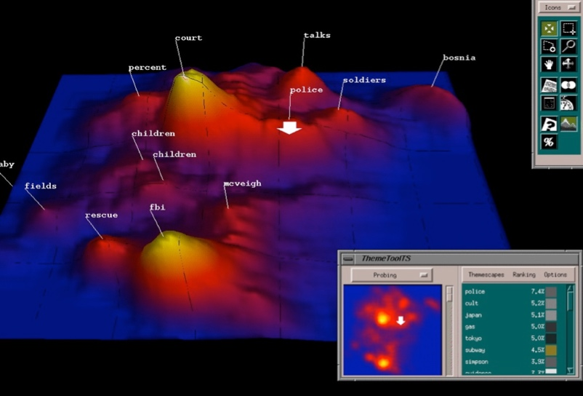

Discussion: what are they all trying to do?

Slide 30

Visualization helps shape mental models
Visualization

Slide 31
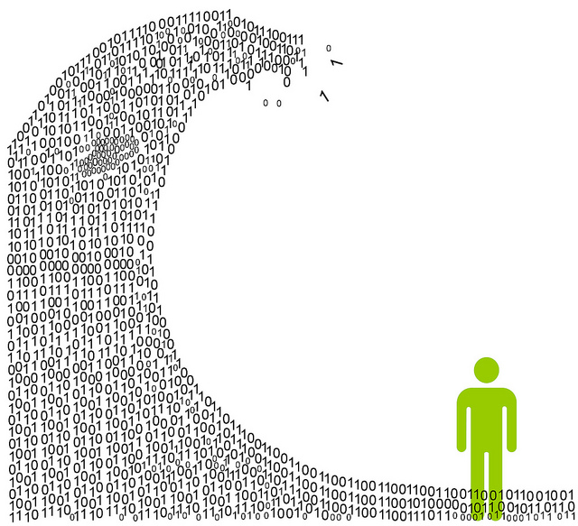
Information overload
We are exposed to huge amounts of information all the time
So much, in fact, that we can’t process it all fast enough

Slide 32

Mental models
To cope, we construct mental models: abstracted, simplified versions of the world that are more manageable

Slide 33

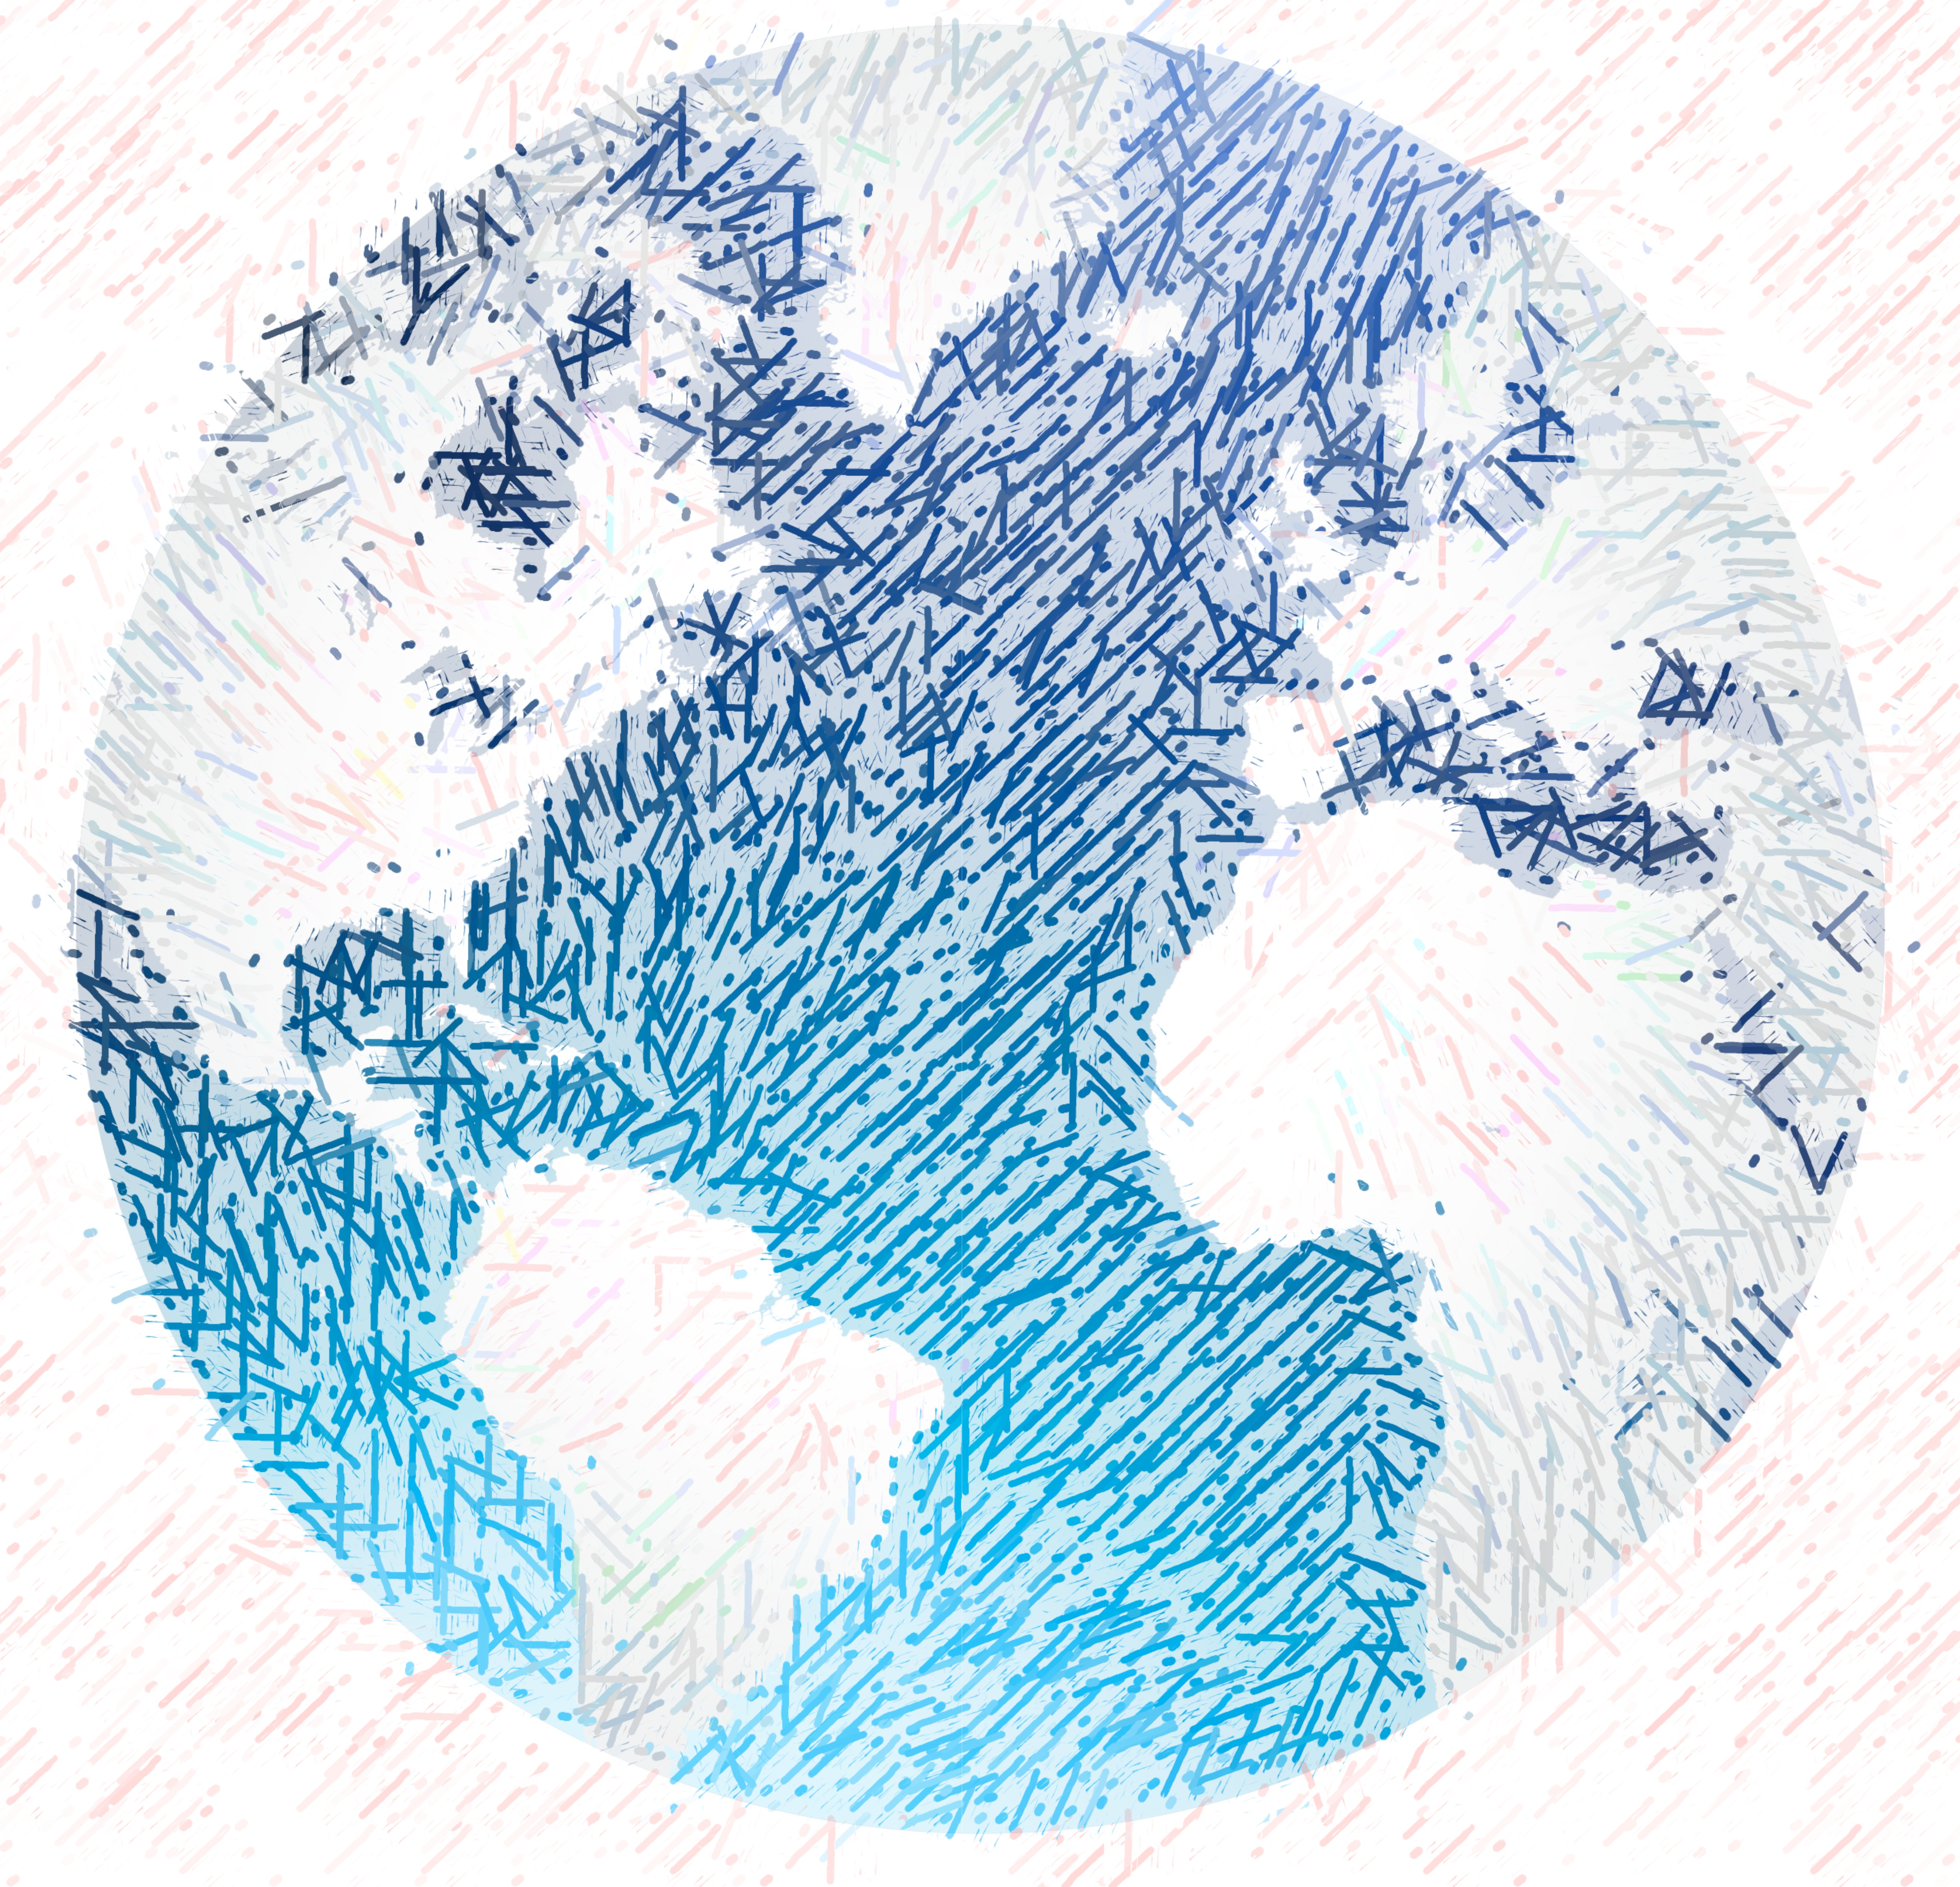

Mental Models: a Sketch

Slide 34
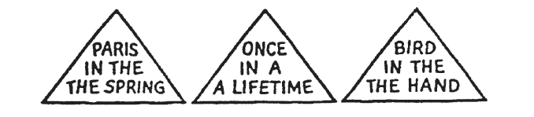
1. We tend to see what we expect to see
Notes:
Mental models are built from prior experience
We expect new input to “fit” the existing model
Updates are expensive: given input that almost fits, we’ll distort information to avoid re-fitting the model
Expectation is at least as strong as perception

Slide 35
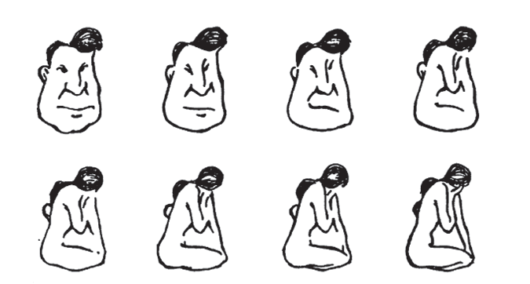
2. Mental models form quickly, & update slowly
Notes:
“First impressions matter”
Early information can have the highest impact
The order in which we present pieces of information can shape how a person understands the whole
Once a mental model is formed, it takes effort to alter it

Slide 36
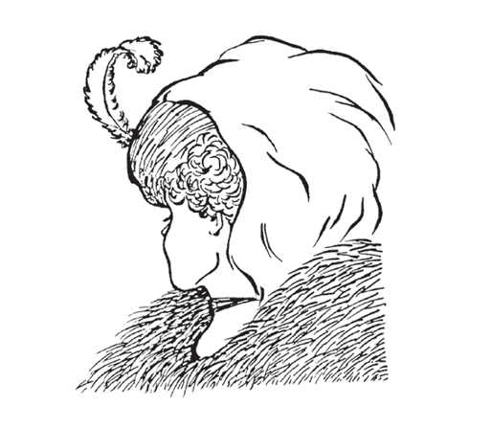
3. New information gets incorporated into the existing model
Notes:
Integrating competing perspectives is challenging
Switching between multiple perspectives is also difficult (visually or mentally)
Tricky part: real-world problem often require such perspective switching

Slide 37
4. Initial exposure interferes with accurate perception
Blur size
128px
64px
32px
16px
8px
None
Notes:
Longer exposure to ambiguous data makes people more confident in their initial model
This is true even if new data presents strong evidence that their model is wrong!
Important: need to be intentional when we design, because incremental information can be misleading

Slide 38
The good, the bad, and the ugly…
The good:
Well-tuned mental models let us process information quickly
Frees up more processing power to synthesize information
The bad:
People (esp. experts) tend not to notice information that contradicts their mental model
A “fresh pair of eyes” can be beneficial
The ugly:
Mental models are unavoidable: everyone has them, and they’re all different
Key: be aware of how mental models form, how they shape perception, and how to support (or challenge) them

Slide 39
So what do we have to work with?

Slide 40

Graphical primitives
The images we draw are composed of marks: like ink
Lines
Points
Areas

Slide 41
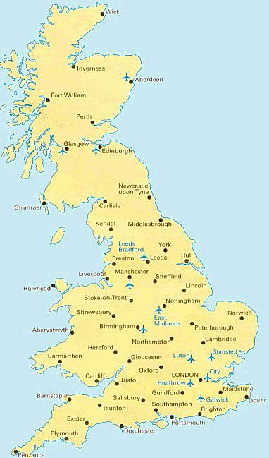
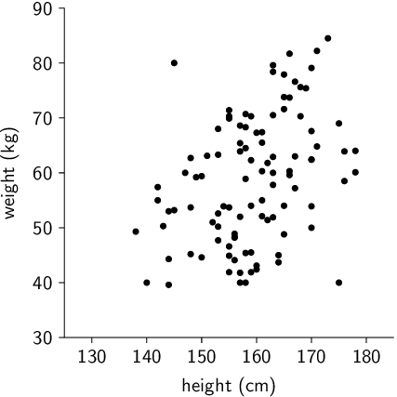
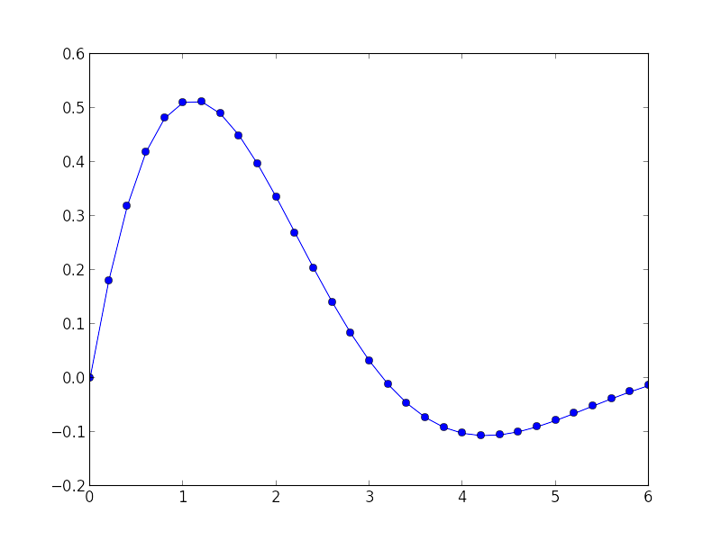
Visual dimension: position
Encode information using where the mark is drawn
Some examples:

Slide 42
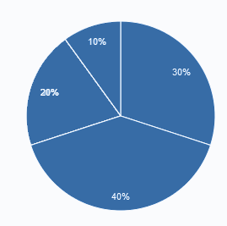
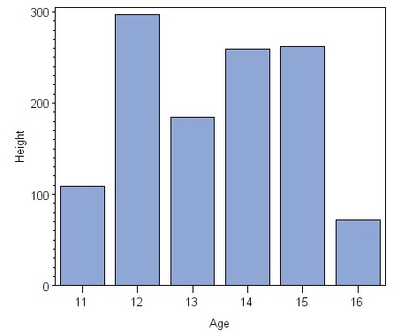
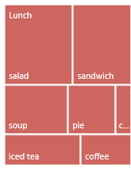
Visual dimension: size
Encode information using how big the mark is drawn
Examples:

Slide 43
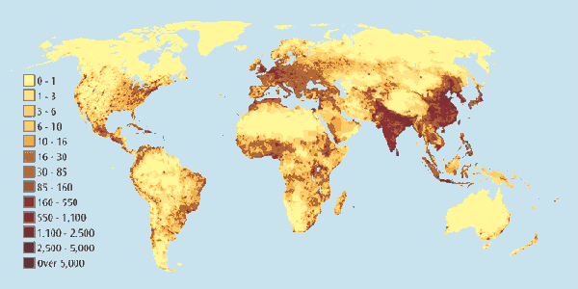
Visual dimension: value
Encode information using how dark the mark is drawn
Example:

Slide 44
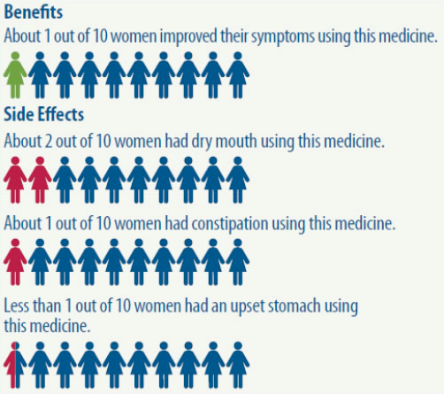
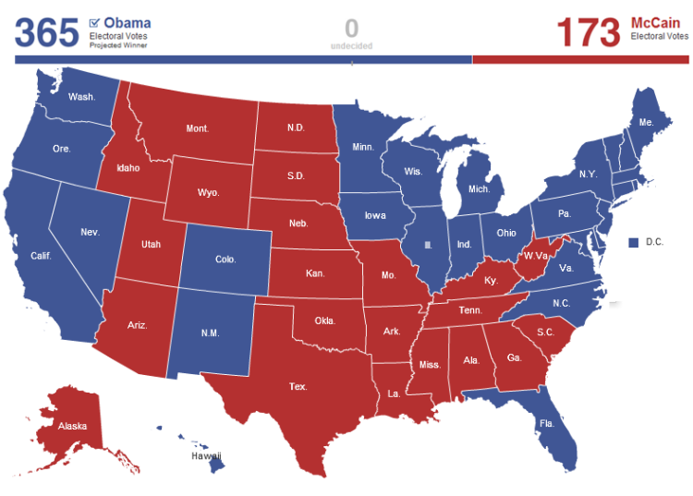
Visual dimension: color
Encode information using the hue of the mark
Examples:

Slide 45
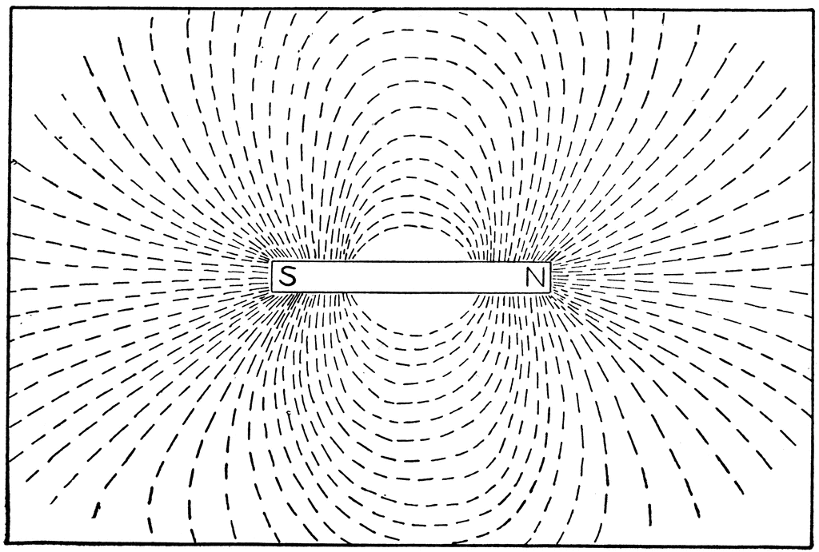
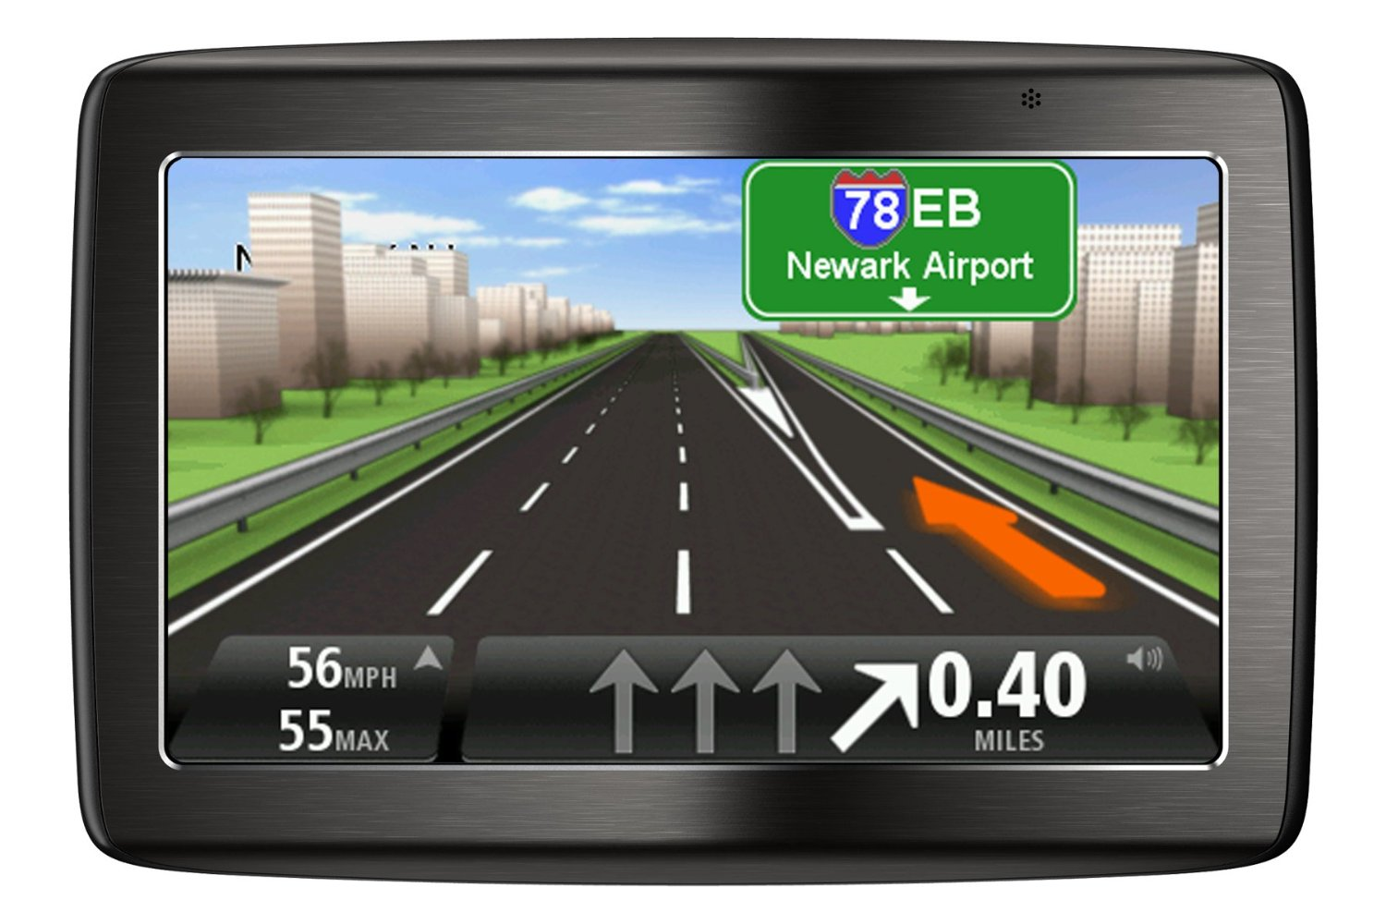
Visual dimension: orientation
Encode information using how the mark is rotated
Examples:

Slide 46



Visual dimension: shape
Encode information using how the mark is shaped
Examples:

Slide 47
Discussion
What makes a good encoding?

Slide 48
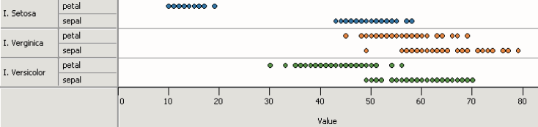
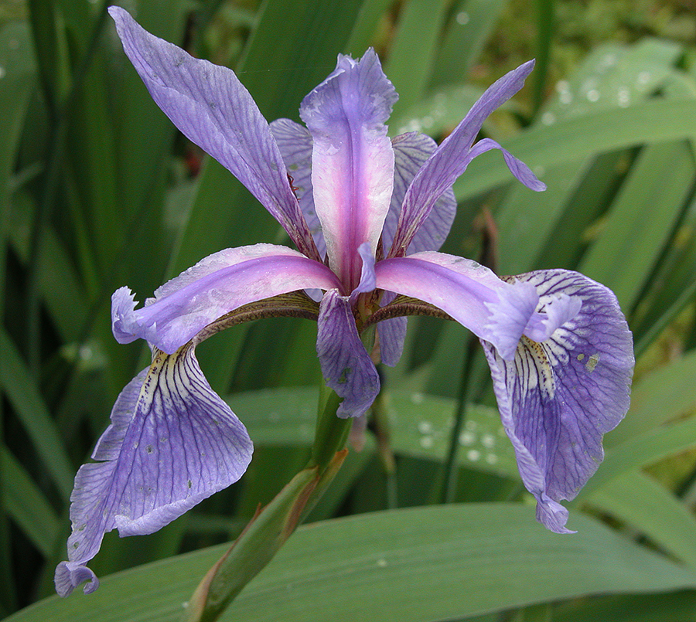
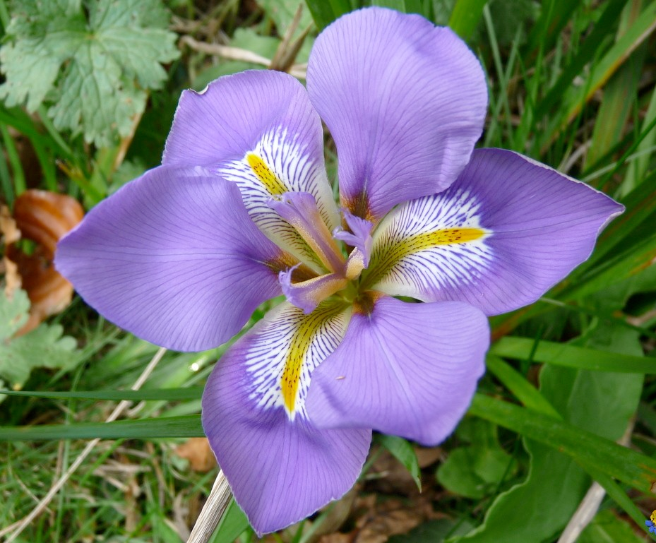
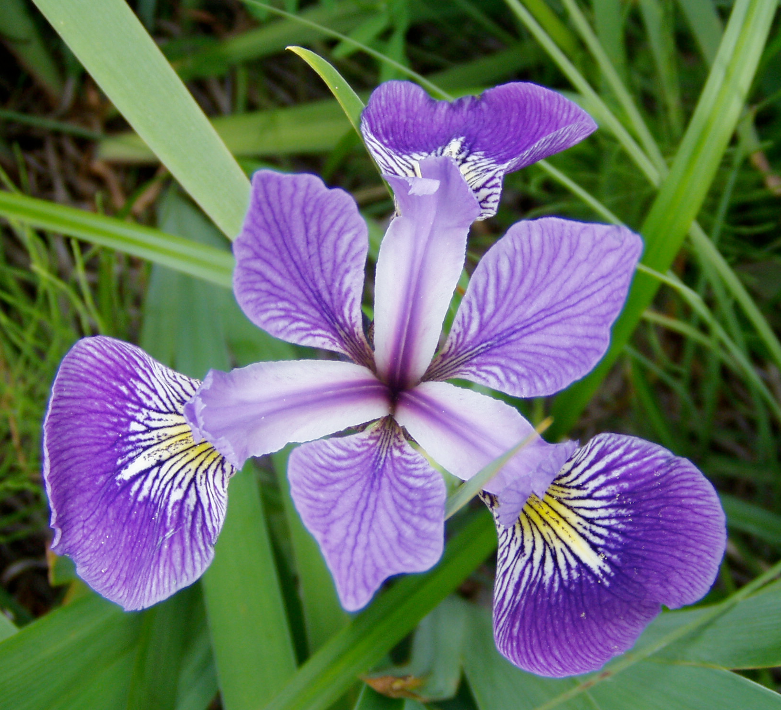
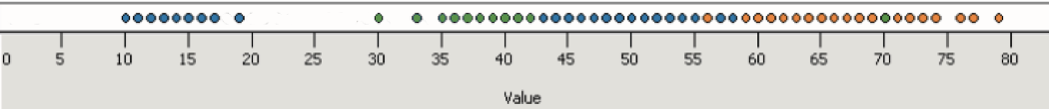
Principle 1: expressiveness
Encodes all the facts
Example:
Fig. Courtesy of M Krzywinski

Slide 49
Principle 1: expressiveness
Encodes only the facts
Example:
Adapted from Mackinlay J (1986) Automating the design of graphical presentations of relational information.

Slide 50

Principle 2: consistency
Use consistent axes when comparing charts
Raina SZ, et al. (2005) Evolution of base-substitution gradients
in primate mitochondrial genomes. Genome Res 15: 665-673.
M. Krzwinski, behind every great visualization is a design
principle, 2012

Slide 51



Principle 2: consistency
A note on legends: order items according to appearance
M. Krzwinski, behind every great visualization is a design principle, 2012

Slide 52




Principle 2: consistency
Visual variation should reflect and enhance the underlying variation in the data
Avoid visually similar encodings for independent variables
Example:

Slide 53


Principle 2: consistency
Uniform size and alignment reduces visual complexity and aids interpretation
Example:
Fig. 1: Sharov AA et al. (2005) Genome-wide assembly and analysis of alternative transcripts in mouse. Genome Res 15: 748-754.
Fig. 2: M. Krzwinski, behind every great visualization is a design principle, 2012

Slide 54

Tufte, 1983
“Above all else, show the data.”

Slide 55
Tufte, 1983

Slide 56


Tufte: maximize the data-ink ratio

Slide 57

Familiar example

Slide 58
Discussion
What do you think of the data-ink ratio?
Consider ways to maximize it…

Slide 59


Principle 3: importance ordering
Avoid unnecessary containment and repetition
Example

Slide 60


Principle 3: importance ordering
Navigational aids shouldn’t compete with data
Avoid: heavy axes, error bars and glyphs
Heer J, Bostock M (2010) Crowdsourcing graphical perception: using mechanical turk to assess visualization design.
Proceedings of the 28th international conference on Human factors in computing systems. Atlanta, Georgia, USA: ACM. pp. 203-212.

Slide 61


Principle 3: importance ordering
Simplify, simplify, simplify…
Sharov AA, et al (2006) Genome Res 16: 505-509.
Peterson J, et al. (2009) Genome Res 19: 2317-2323.
Thomson NR, et al. (2005) Genome Res 15: 629-640.
DB, Ko MS (2005) Genome Res 15: 748-754.
M. Krzwinski, behind every great visualization is a design
principle, 2012

Slide 62


A caveat: “chart junk” and recall
Bateman et al. “Useful Junk? The Effects of Visual Embellishment on Comprehension and Memorability of Charts”, CHI 2010

Slide 63


Chart junk and eye gaze

Slide 64
Lab 1: Deconstructing Data Graphics
Break into groups of 2-3 people, and go to:
www.science.smith.edu/~jcrouser/SDS136/labs/design
During this lab, we’ll critique some professionally-made visualizations using these principles
Try to think about the following questions:
What is the first thing you notice about this visualization?
What point is this visualization trying to make?
Who is the intended audience?
What is the visualization doing well?
What problems do you see with the visualization design?
Why do you think the designer made those choices?

Slide 65


Slide 66


Slide 67


Slide 68


Slide 69


Slide 70


Slide 71


Slide 72


Slide 73


Slide 74


Slide 75


Slide 76


Slide 77
Coming up next
Grammar of graphics
Introduction to ggplot2
Lab: Make a Scatterplot

